Slide 1

Early Diabetes Detection
by Ankur Gopal Maheshwari

Slide 2
Introduction
According to American Diabetes Association (ADA), total estimated diagnosed diabetes costs over $412 Billion Dollars Annually.
According to Center for Disease Control and Prevention (CDC) for the year 2017-2020:
101,209 Mortality rates
11.6% (38.4 Million people) were diagnosed with diabetes
3.4% (8.7 Million people) were unaware they had diabetes
29.2% of Adults over 65 years had diabetes
Reduced work productivity accounted for $35.8 billion in annual indirect costs
Missed workdays (Absenteeism) accounted for $5.4 billion in annual indirect costs
Diabetic patients on average spent $12,022 annually.

Slide 3

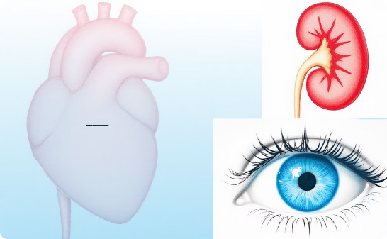

Problem Statement
Early Detection & Prevention
Prevent Serious Complications
Identify Key Lifestyle Impacts
Focus on early detection and prevention for Type 2 Diabetes, which is often caused by lifestyle and genetic factors.
Prevent the escalation of diabetes into serious chronic conditions like heart disease, stroke, kidney failure, and vision loss.
Identify which lifestyle behaviors (e.g., inactivity, poor diet, smoking) most strongly impact diabetes risk.

Slide 4




Opportunities and Impact
Reduce Healthcare Burden
Empower Personalized Prevention
Inform Public Health Policy
Target At-Risk Groups with Timely Care
Opportunity to significantly reduce the financial burden on the U.S. healthcare system, leading to billions in saved treatment costs.
Empower individuals with personalized prevention strategies effectively derived from detailed health data and insights.
Provide public health agencies and policy makers with crucial data-driven insights to develop and implement targeted campaigns.
Enable health care providers to proactively identify at-risk people and facilitate timely and effective early interventions.

Slide 5





Proposed Vision-Using Data Science Methodology
Data Acquisition & Pre-Processing- Done
Clean, Transform and do feature selection and engineering on data.
Exploratory Data Analysis -Done
Use visualizations to understand key features and their distribution, outliers and relationships.
Hypothesis Testing & Correlation Analysis -Done
Apply statistical tests like Chi-Square and t-test to validate associations of feature to diabetes. Also, use correlational heatmap and VIF to determine feature significance.
Predictive Modeling
Build classification models (e.g. Logistic Regression, Decision Tree, Random Forest & XGBoost) and use tools like accuracy, precision, recall, ROC Curve, confusion matrix & F1 score to evaluate the model
Model Interpretation & Insights
Interpret the model outputs to identify drivers of Diabetes and translate findings into actionable insights

Slide 6

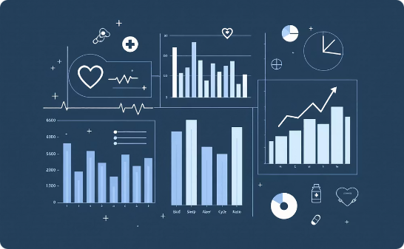

Dataset
Extensive Data Collection
Rich Feature Set
Clear Target Variable
253,680 records collected from individuals via telephonic survey (CDC BRFSS 2015) extracted from UCI
21 key features recorded including BMI, smoker status, insurance, physical and mental health, fruits & veggies intake, and alcohol consumption.
A binary indicator (Diabetes Class)
0- No Diabetes
1- Has Diabetes

Slide 7

Data Quality & Concerns
Feature types reviewed: Mix of binary, categorical, and numerical fields.
Target variable simplified: Collapsed 3 diabetes classes (0: no, 1: pre-diabetic, 2: yes) into a binary format (0: no, 1: yes) for clearer prediction
Dropped ~10 % of exact duplicate records to ensure data integrity
No null values: Dataset was complete — no imputation required
Class imbalance identified: ~85% non-diabetic vs. 15% diabetic → need to address during modeling
One-hot encoding for categorical variables (e.g., General health)
Ordinal encoding for ranked categories (e.g., age group, education level, income)

Slide 8
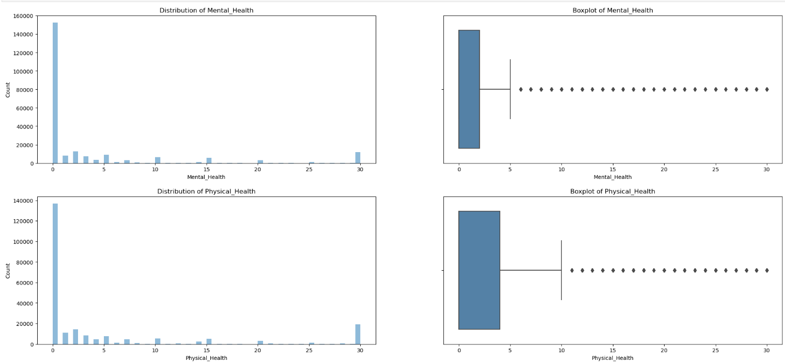
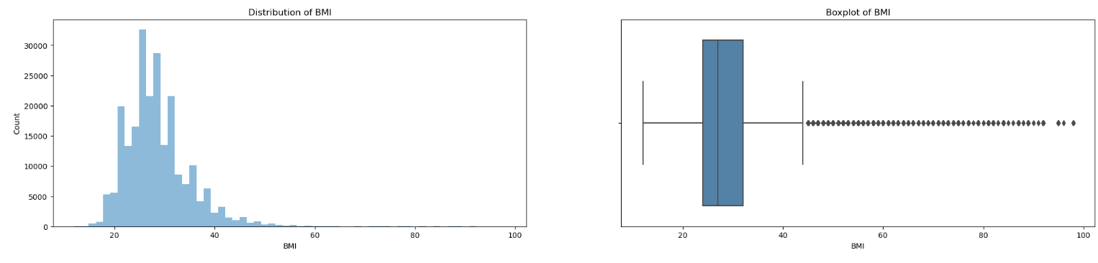
EDA- Distribution of Numerical Features
Mental Health Days:
Highly right-skewed Distribution
Mostly spread is from 0-2 days
Outliers > 5 days
Physical Health Days:
Highly right-skewed Distribution
Mostly spread is from 0-4 days
Outliers > 10 days
BMI Distribution:
Closer to Normal Distribution
Majority of values fall between 24–32 range.
Outliers > 45 mostly obese
Implication:
These variables (BMI, Mental/Physical Health) may be strong indicators of diabetes risk and will need normalization during modeling.

Slide 9
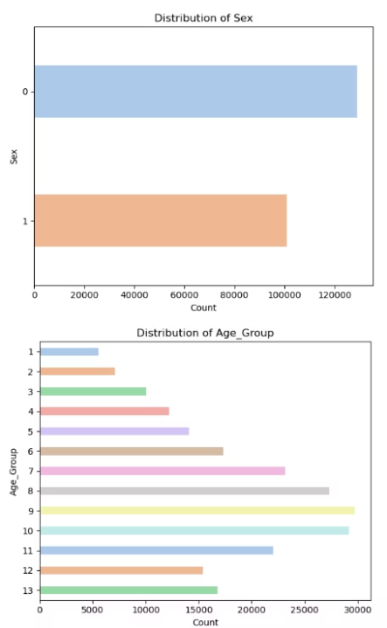
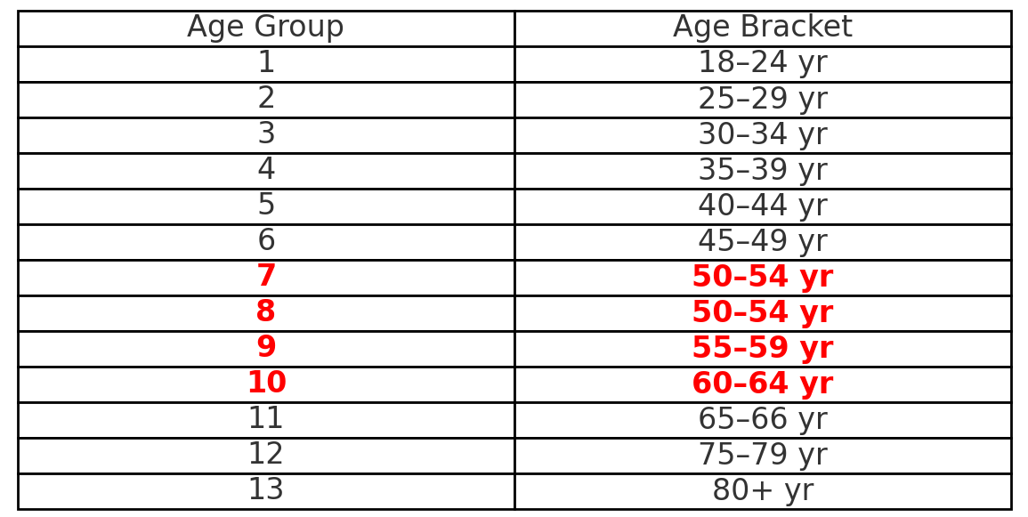
EDA- Distribution of Categorical Features
Sex Distribution:
Slightly more female respondents (0 = Female, 1 = Male).
Balanced enough to ensure gender diversity in predictions (good for modeling)
Age Group Distribution:
The dataset is skewed towards older age groups (50+), particularly 50–65 yr
Implication:
Age and gender will be important variables in modeling.
Class distribution should be considered in stratified train-test split
due to class imbalance as well as SMOTE

Slide 10
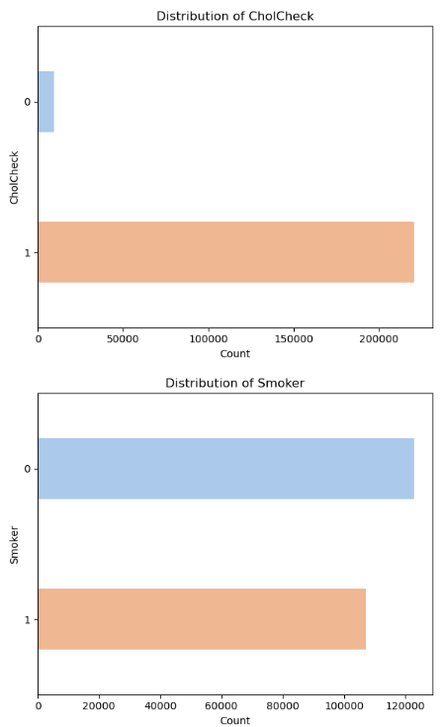
EDA- Distribution of Categorical Features
Cholesterol Check (CholCheck: 1 = Yes, 0 = No)
Vast majority of participants had a cholesterol check in the past 5 years.
Only a small portion reported not getting tested, which may reflect better general access to preventive care.
Smoking Status (Smoker: 1 = Yes, 0 = No)
Roughly 45% of the population are smokers, highlighting a significant lifestyle risk.
Indicates potential for behavioral modification campaigns alongside diabetes risk prediction.
Implication:
Both features may help distinguish health-conscious vs. high-risk groups.
Could be important in public health profiling and targeting preventive interventions.

Slide 11
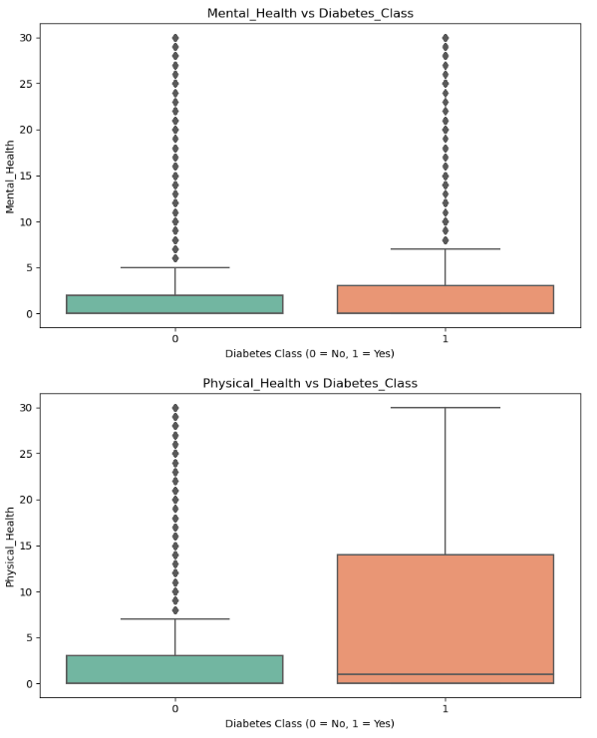
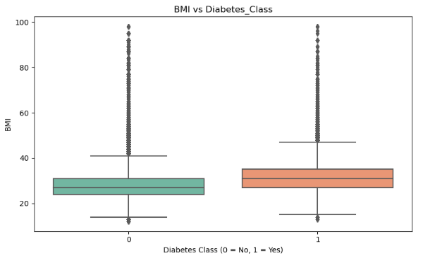
Multi-Variate- Numerical Features
Mental Health (Days) vs Diabetes Class
Median mental health days are higher for those with diabetes
Physical Health (Days) vs Diabetes Class
Median Physical health days are significantly higher for those with diabetes
BMI vs Diabetes Class
BMI is higher for Diabetic Patients vs Non-Diabetic Patients
Implication:
Individuals with Higher BMI and more days off for physical & mental health reasons are more likely to be diabetic.

Slide 12
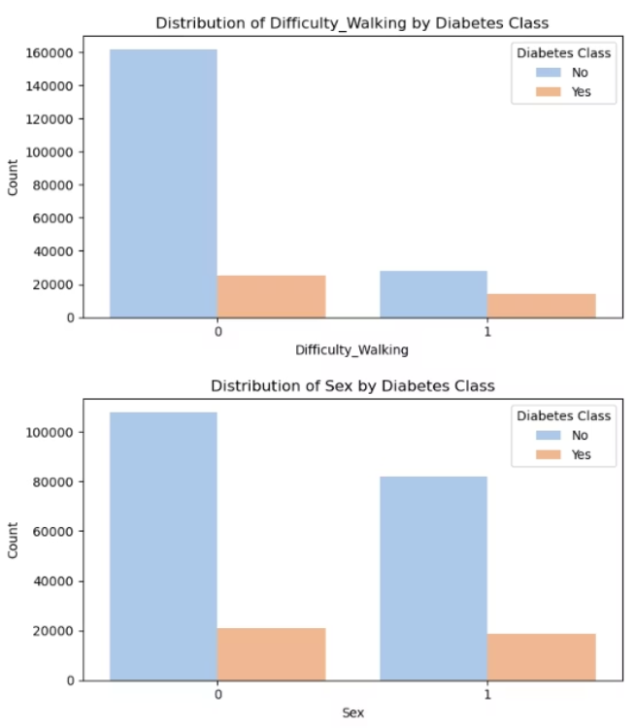
Multi-Variate- Categorical Features
Difficulty Walking vs Diabetes Class
A larger proportion of people with diabetes (Class = 1) report difficulty walking (value = 1) compared to those without diabetes.
Among individuals who do not have difficulty walking (value = 0), the majority are non-diabetic.
Sex vs Diabetes Class
Both males and females show similar proportions of diabetes
Implication:
Difficulty walking is likely a strong indicator of diabetes, possibly due to diabetic complications like neuropathy or mobility-related comorbidities
Sex may not be a strong standalone predictor, though it could interact with other variables like age or BMI.

Slide 13
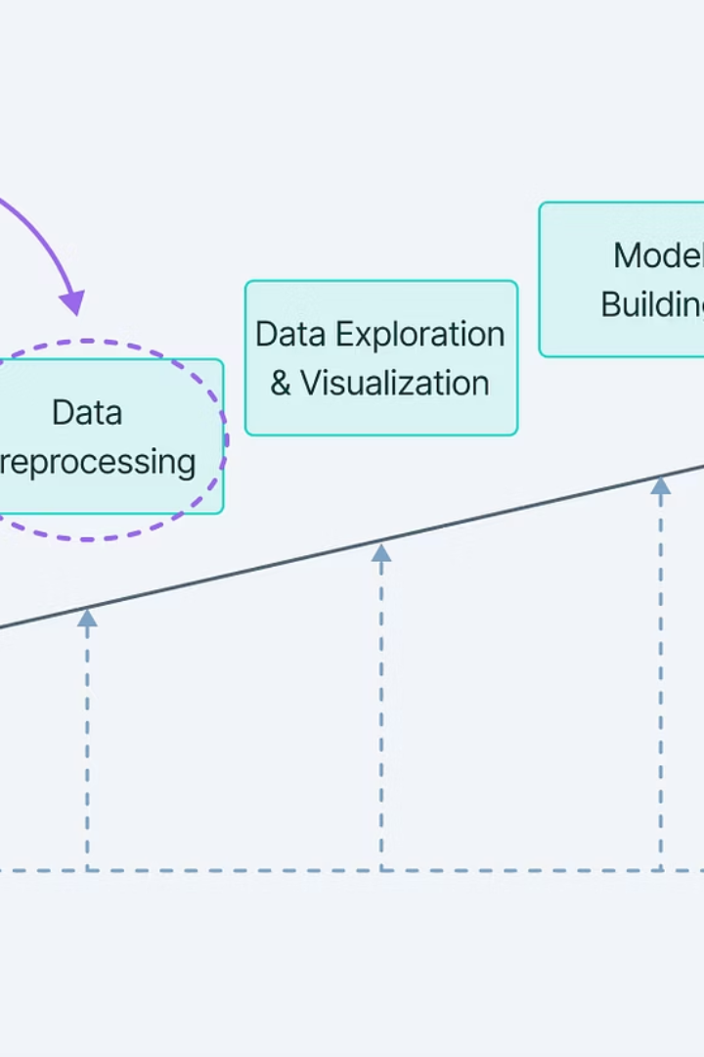
Laying the Groundwork for Future Work-
Train-Test Preparations- Stratify (Split Train-Test) , SMOTE (on Training set) and Normalize (fit on Train & apply on both set)
Baseline Modeling & Evaluating- Logistic Regression
Advanced Modeling- Random Forest, Decision Tree & XGBoost
Interactive Dashboard & App

Slide 14

Conclusion
The goal of the project was determined and a DS methodology framework was designed
Data was imported, understood, cleaned and formatted
Exploratory data analysis was done to understand the relationship between key features
Feature Engineering and Selection was done
Next steps for sprint 2 were identified

Slide 15
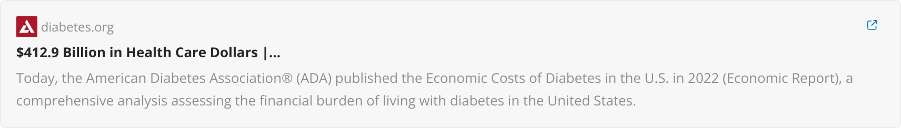

References

